Slide 1
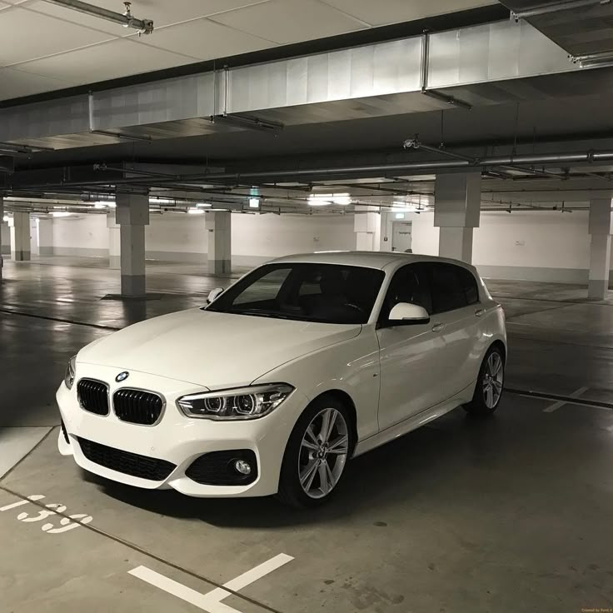

HOME SERVICE ABOUT US CONTACT US
CAR RENTAL SERVICE
P R E S E N T A T I O N

Slide 2



HOME SERVICE ABOUT US CONTACT US
MEET OUR INSTRUCTOR
Mam Ramsha Khalid
Muhammad Mudassir

Slide 3



HOME SERVICE ABOUT US CONTACT US
MEET OUR TEAM
Muhammad Asad
Muhammad Tayyab
Muhammad Awais Asif

Slide 4



HOME SERVICE ABOUT US CONTACT US
MEET OUR TEAM
Mubeen Fatima
Ayesha Jehangir
Adeena Fatima

Slide 5
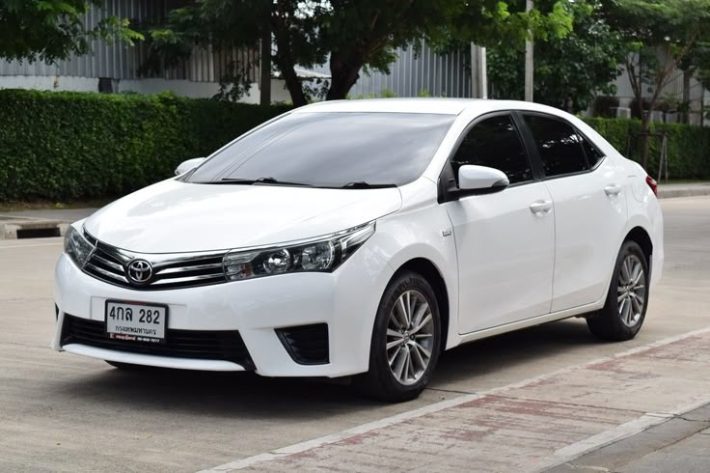
HOME SERVICE ABOUT US CONTACT US
INTRODUCTION
The Car Rental Services project is a web-based platform developed to provide convenient and reliable car rental solutions. It allows users to easily rent vehicles online, addressing the inefficiencies of traditional agent-based methods. With the increasing number of travelers and overseas visitors, the platform enables users to reserve cars anytime and anywhere using mobile phones or internet-enabled devices. The website offers a simple, user-friendly interface and online booking facilities, making the rental process faster, more transparent, and more convenient. Overall, the project demonstrates how technology can solve real-world problems and improve services for society.

Slide 6


HOME SERVICE ABOUT US CONTACT US
WELCOME TO OUR WEBSITE
Welcome to our AICT Lab Project presentation. In this project, we have designed and developed the front-end of a car rental website. The website allows users to explore our cars, view services, and easily navigate through pages like Home, Services, About Us, Contact, Sign In, and Sign Up.

Slide 7

HOME SERVICE ABOUT US CONTACT US
OUR VISION
& MISSION
VISION
To create a seamless, user-friendly, and accessible online car rental platform that makes renting vehicles easy, fast, and convenient for everyone, anywhere, at any time.
MISSION
Our goal was to create an attractive and user-friendly interface that makes booking a car simple and convenient. This project helped us learn teamwork, HTML, CSS, and how to present a real-world solution effectively.

Slide 8



HOME SERVICE ABOUT US CONTACT US
LINKS
Website
GitHub

Slide 9


Slide 10
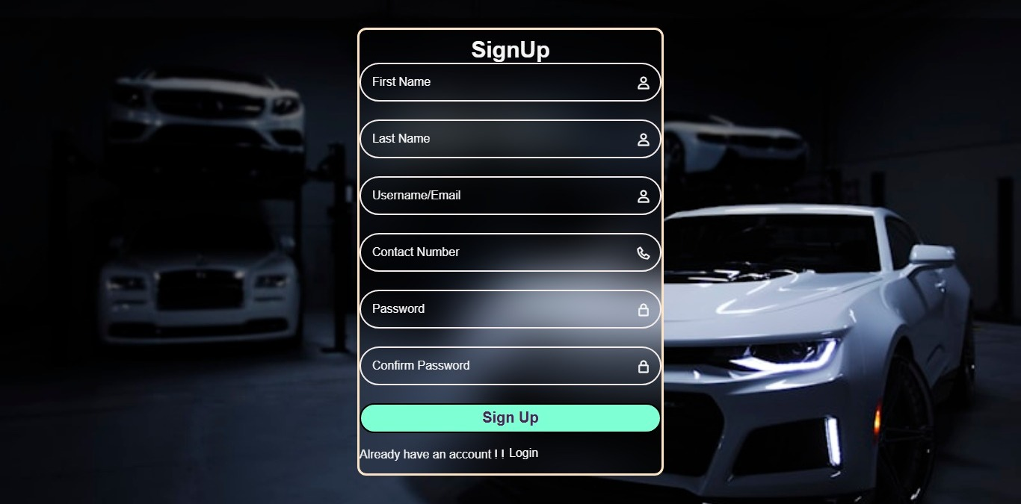
SIGN UP
The Sign-up page is used for new users
It is required when a client wants to use the company’s services for the first time
The user enters personal information such as:
1. Name
2. Email Address
3. Password
4. Contact Number
This information is used to create an account on the website
PURPOSE
To create a new user account
To register the user on the website
To allow the user to access rental car services

Slide 11
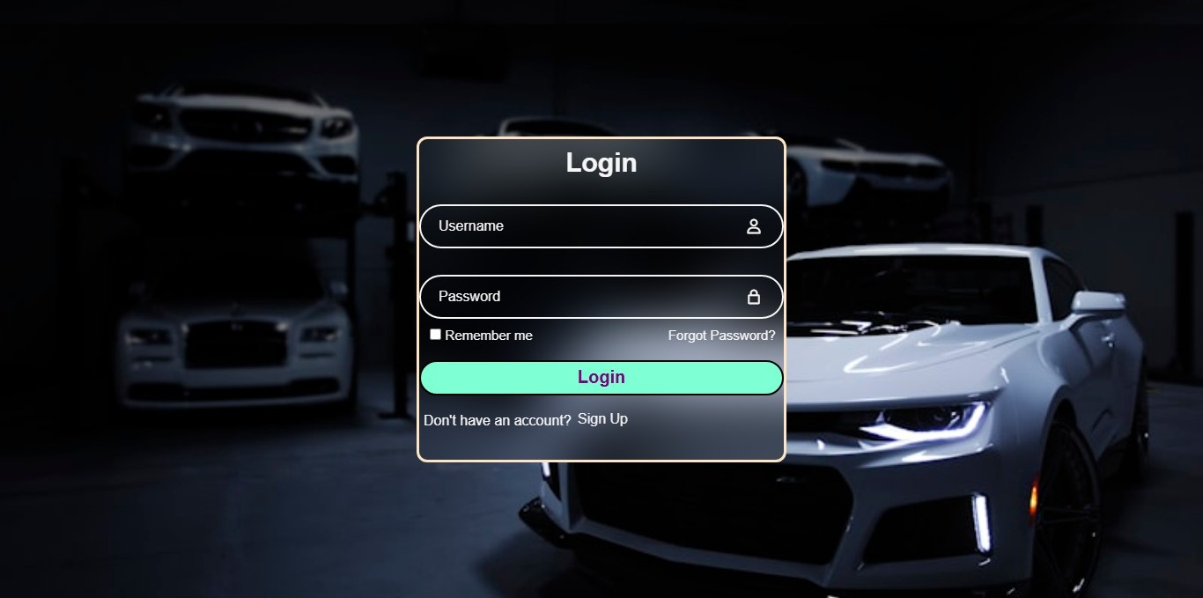
To authenticate the user
To allow the user to log in to the website
To give access to the company’s rental car services
SIGN IN
The Sign In page is used by existing users
It is used when the user already has an account on the website
The user enters only:
1. Username
2. Password
The information is the same as created during the Sign-up process
The Sign In page requires less information than the Sign-up page.
PURPOSE
To authenticate the user
To allow the user to login the website
To give access to the company’s rental car services

Slide 12
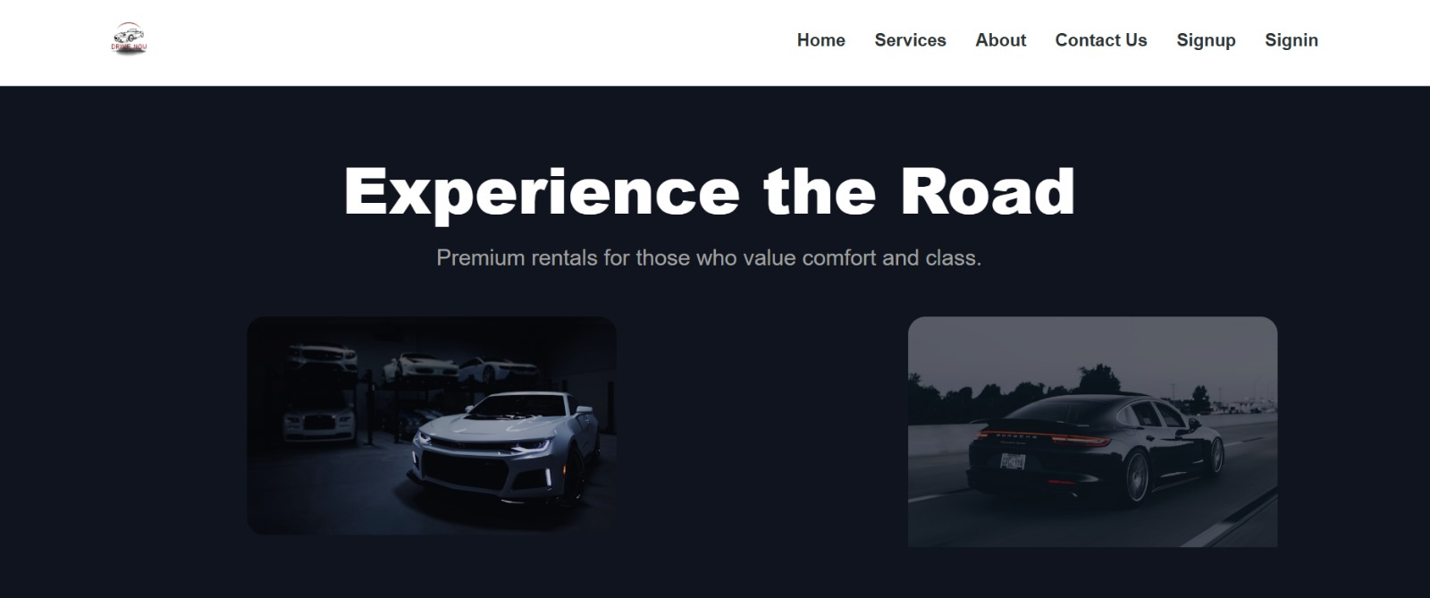
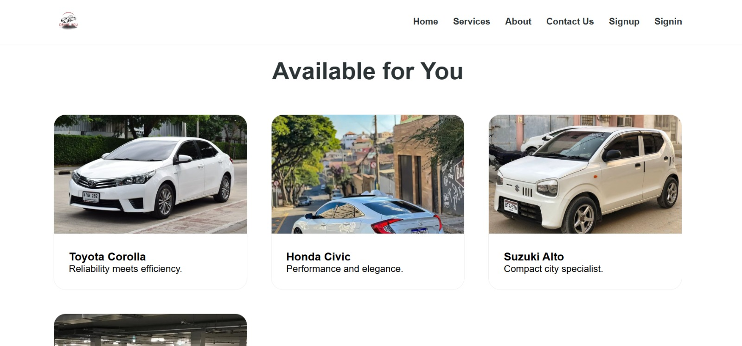
HOME SERVICE ABOUT US CONTACT US
HOME PAGE
The home page is the main landing page of the website, showing an overview of the company and images of available cars. It has a header with the logo and navigation buttons for all pages, and a footer with company information. It includes a header with a navigation bar, featuring the company logo on the left and buttons for Home, Services, About Us, Contact Us, Sign In, and Sign Up on the right. The design is attractive to create a strong first impression

Slide 13
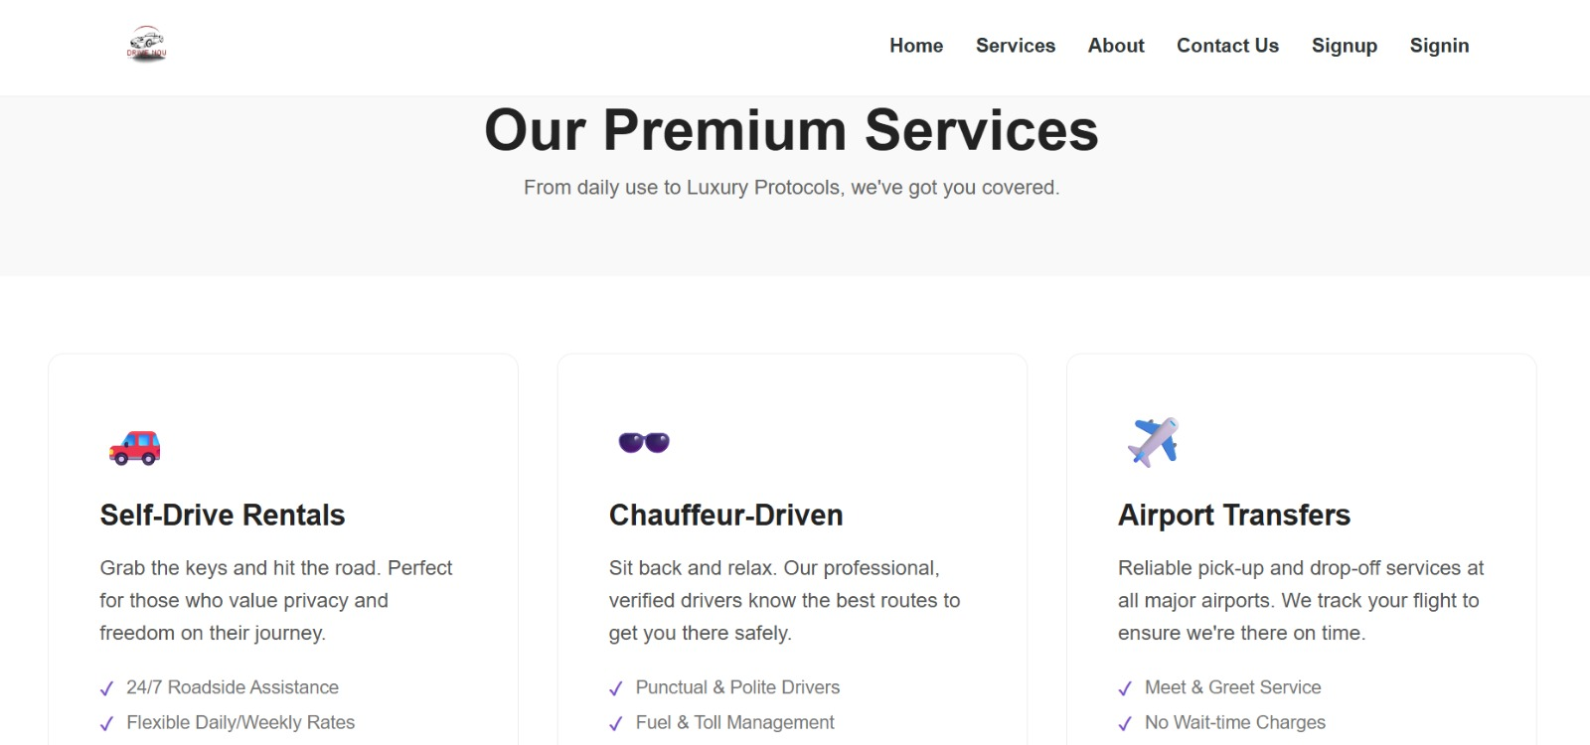
HOME SERVICE ABOUT US CONTACT US
SERVICES
Shows clients the variety and types of cars available for rent.
Helps users choose cars to make their moments more enjoyable.
Includes a footer with a “Book Now” button for instant booking.
Designed for easy and convenient car rental at a glance.

Slide 14
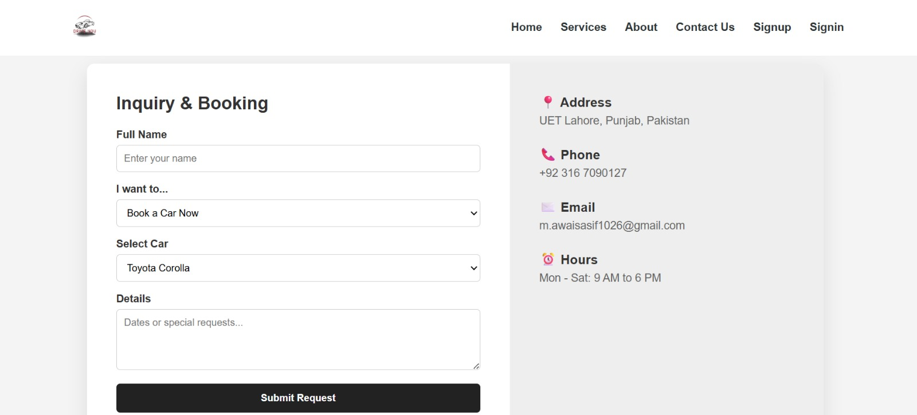
HOME SERVICE ABOUT US CONTACT US
CONTACT US
The Contact Us page is used by clients to contact the company.
Clients can reach us through email or phone number.
If they face any issue with the service, they can contact us for help.
Problems related to the car or services are handled on this page.
Customers can also share their feedback or reviews.
The main purpose of this page is to provide customer support and assistance.

Slide 15
HOME SERVICE ABOUT US CONTACT US
PRICING TABLE
The pricing table shows the daily rental price of each car.
Prices are set according to the car category (Economy, Sedan, SUV, Luxury).
Economy cars have low rental charges and are affordable.
Luxury and SUV cars have higher prices due to comfort and features.
The price mentioned is per day and may vary based on availability.
Customers can compare prices easily and choose a suitable car.

Slide 16
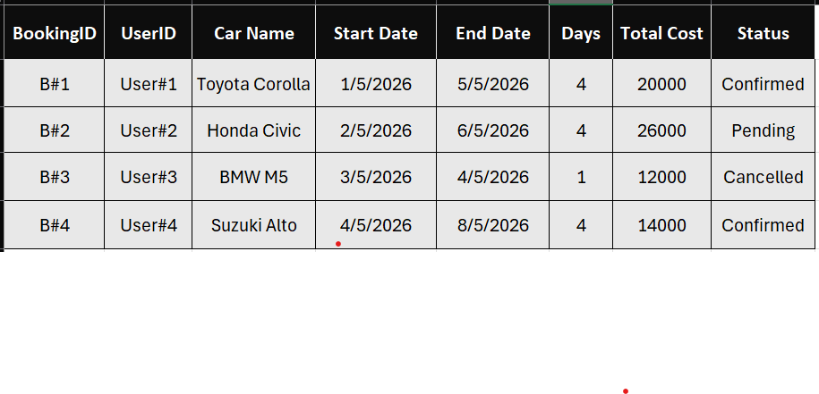
HOME SERVICE ABOUT US CONTACT US
CAR BOOKING DETAILS
This table shows the complete booking details of customers.
Each booking has a unique Booking ID and User ID.
It displays the car name booked by the user.
The start date and end date show the rental period.
The number of days is calculated based on booking dates.
Total cost is calculated according to price per day and total days.
The status shows whether the booking is Confirmed, Pending, or Cancelled.
This table helps in managing and tracking bookings efficiently.

Slide 17





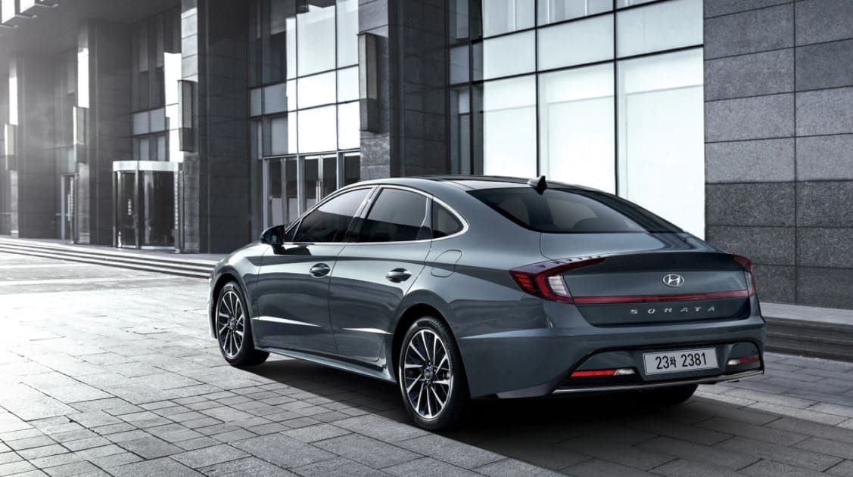
HOME SERVICE ABOUT US CONTACT US
OUR BEST SERVICE
We provide reliable and high-quality car rental services.
Our vehicles are well-maintained and safe for customers.
We offer easy online booking with quick confirmation.
Our service is available at affordable and reasonable prices.
We ensure 24/7 customer support for any issues or assistance.
Customer satisfaction and comfort are our top priorities.

Slide 18




HOME SERVICE ABOUT US CONTACT US
THANK YOU
+923 1670 90127
www.drivenow.com
m.awaisasif1026@gmail.com

